Slide 1
LOGIC AND FAULT SIMULATION
P.RAJESH
Department of E.C.E
JNTUA C.E.A

Slide 2
Introduction
Example :
Assume for a moment that you are a dress designer. You have designed an exquisite garment. Before you cut the cloth, you would like to make sure that the design is correct and the pieces will fit together. Once the cloth is cut, it will be too late to discover any errors in the design. Therefore, a dress designer often uses paper cuttings to verify the design. That is a form of simulation. The idea of simulation is to predict the result of building the desired object without actually building it.

Slide 3
1.Simulation for Design Verification
Simulation serves two distinct purposes in electronic design.
First, it is used to verify the correctness of the design and second, it verifies the tests.
Simulation for design verification.

Slide 4
The process of realizing an electronic system begins with its specification, which describes the input/output electrical behavior (logical, analog, and timing) and other characteristics (physical, environmental, etc.)
The process of synthesis produces an interconnect of components (called a netlist.)
The design is verified by a true-value simulator. True-value means that the simulator will compute the response for given input stimuli without injecting any faults in the design.
Typically, these stimuli correspond to those input and output specifications that are either critical or considered risky by the synthesis procedures.
A frequently used strategy is to exercise all functions with only critical data patterns.
The true-value simulator computes the responses that a circuit (if built using the netlist) would have produced if the given input stimuli were applied.
In a typical design verification scenario, the computed responses are analyzed (either automatically, or interactively, or manually) to verify that the designed netlist performs according to the specification.
If errors are found, suitable changes are made, until responses to all stimuli match the specification.

Slide 5
Strengths and weaknesses of Simulation Based Design…
strength lies:- In circuit behavior that can be simulated.
Example: logic, timing, and analog behaviors can be simulated.
Another advantage is in the use of hierarchy:
Example:
A design can be first simulated at a higher behavior level. Instead of a netlist, the design may be described in a programming language such as C. Such a description is compact, but does not contain the detailed timing information. Neither is the electrical behavior (or possible malfunction) of components considered at this level.
Once this design is verified, higher-level blocks (or C language subroutines) are replaced by logic-level netlists. At this point, a logic simulator is used for verification.
The process may be repeated by replacing some or all portions by transistor-level or circuit-level implementations. Simulation is used in this way for verifying very large electronic systems.

Slide 6
Strengths and weaknesses of Simulation Based Design…
Weakness lies:-
This method is its dependence on the designer’s heuristics used in generating the input stimuli. To contain the complexity, these stimuli are non-exhaustive and, therefore, a guarantee of conformance to specification is impossible. Such a guarantee is possible with a formal verification method.
A restricted form of formal verification, known as model checking, verifies finite state concurrent systems by an exhaustive search of the state-space. It verifies whether a given specification is true.
An efficiently implemented model checking procedure will always terminate with a yes/no answer.
In spite of the incompleteness, simulation provides a better check on the manufacturability of the design.
An ideal system of design verification should combine the behavior-level formal verification with the logic and circuit-level simulation.

Slide 7
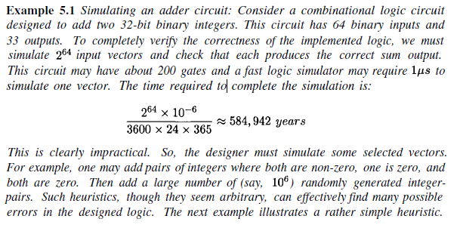

Slide 8
Simulation for Test Evaluation
Another type of simulator, known as a fault simulator, is used for the development of manufacturing tests.
A fault simulator incorporates many of the details of a true-value simulator. In addition, it also has the capability to simulate the circuit response in the presence of faults.
A typical application of a fault simulator in the digital design process.

Slide 9
Fault simulation is normally done after the design has been verified and the verified circuit netlist and verification vectors are available.
These two inputs to the fault simulator are shown as the shaded boxes in above Figure .
The fault simulator performs two functions:
1. It determines the coverage of a given set of input stimuli (vectors) for a given fault model or a given fault list.
2. With the help of other programs (a test generator or a vector compacter, it can produce a set of vectors with a given fault coverage for manufacturing test.
If no fault list is supplied, the fault simulator generates one for the specified fault model.

Slide 10
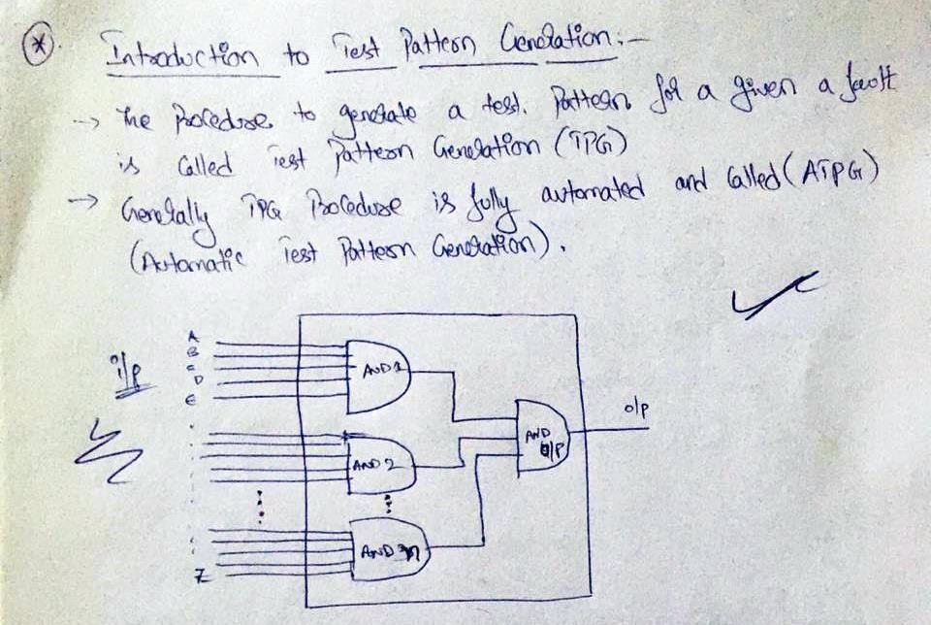

Slide 11
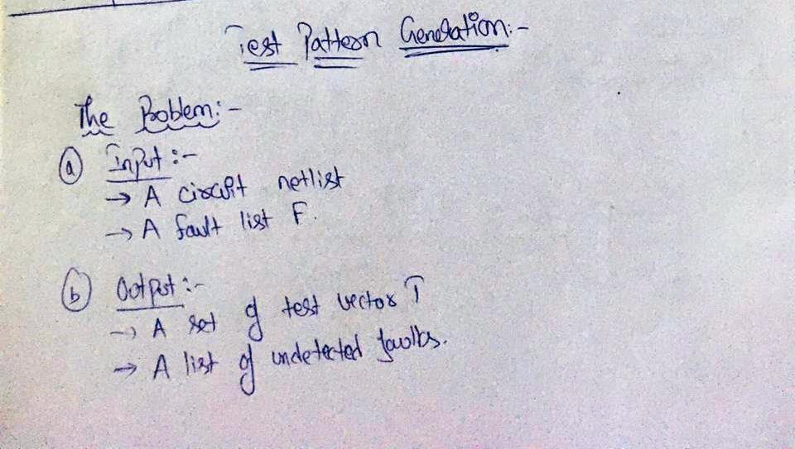

Slide 12
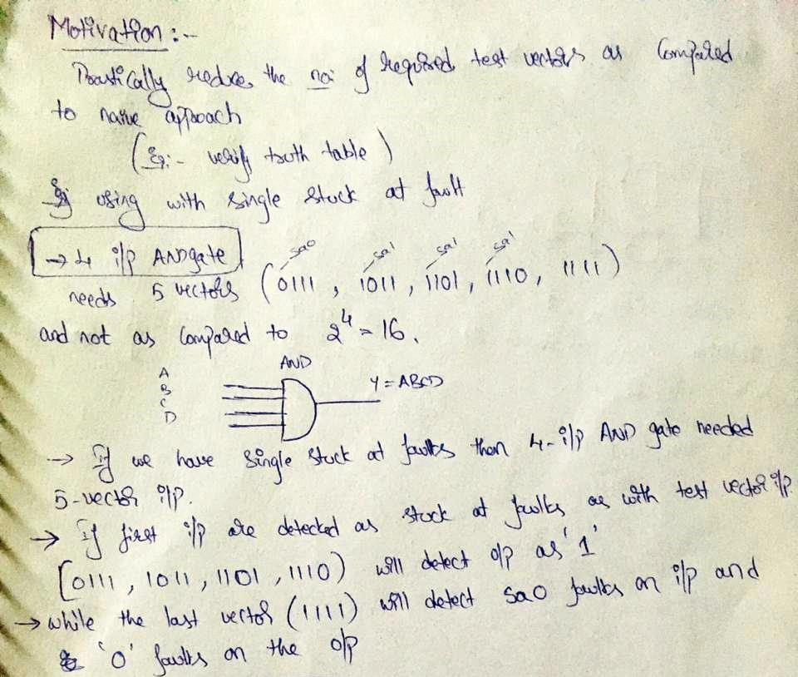

Slide 13
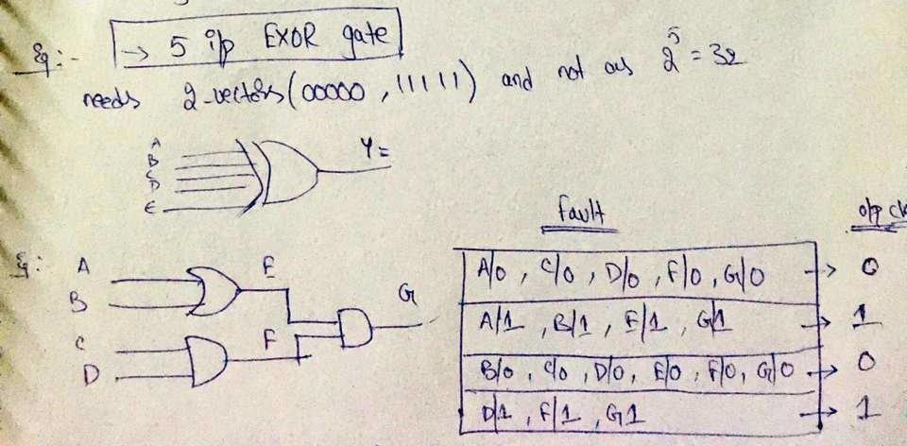
handwritten\ex.pdf

Slide 14
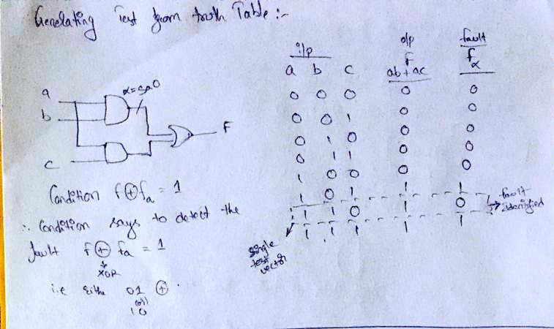

Slide 15
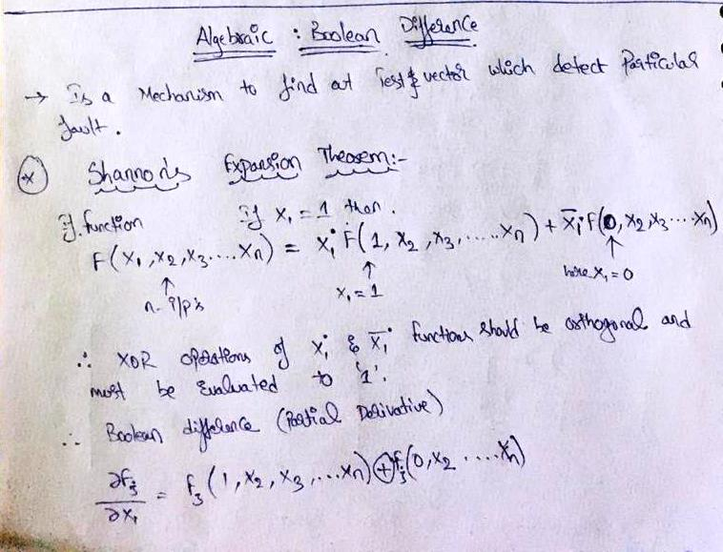

Slide 16
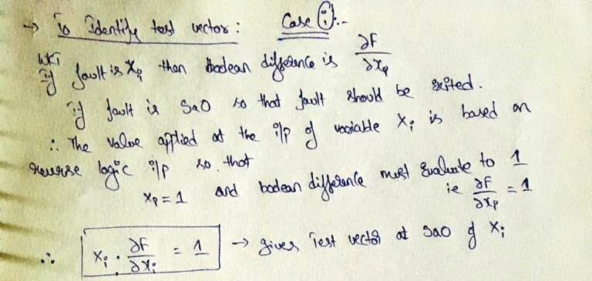

Slide 17
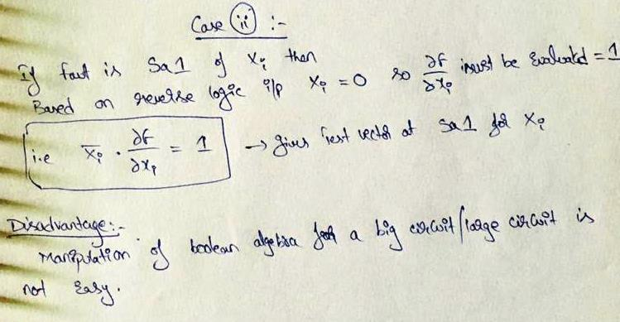

Slide 18
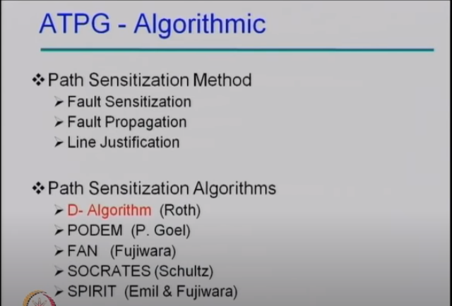

Slide 19
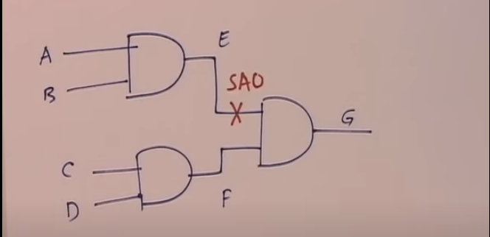
Step 1: Need to find Distinguishable input vector that can define a faulty and fault free output
Case 1:
IF E line Stuck at 0 then output cant be defined as 1 so on applying opposite value as 1 at Line E which is known as Fault sensitization or faulty activation.
IF E line is logic ‘1’ then need to justify the inputs A&B = 11 as to get E=1 this is said as Line justification.
Case 2:
On justifying E=1 then the fault of SA0 is shifted to output G to define this we consider F=1 so that on comparison of C&D=11 we assign F=1
On Applying Test vector as (1111) at input the output G cand be 1 as fault Free and if 0 it is Fault detect at E-line

Slide 20
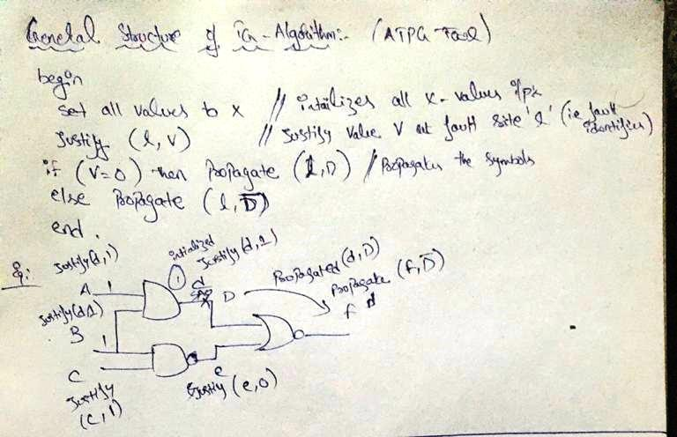

Slide 21
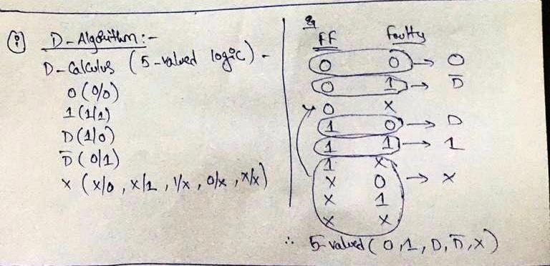

Slide 22
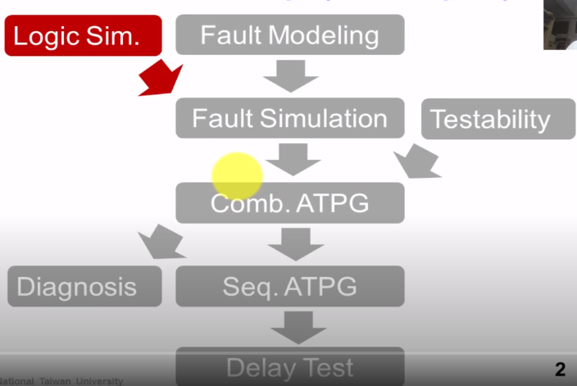
2. Modeling Circuits for Simulation

Slide 23
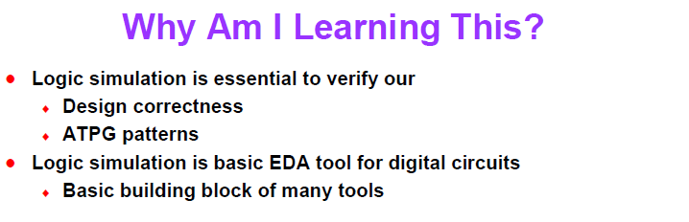

Slide 24
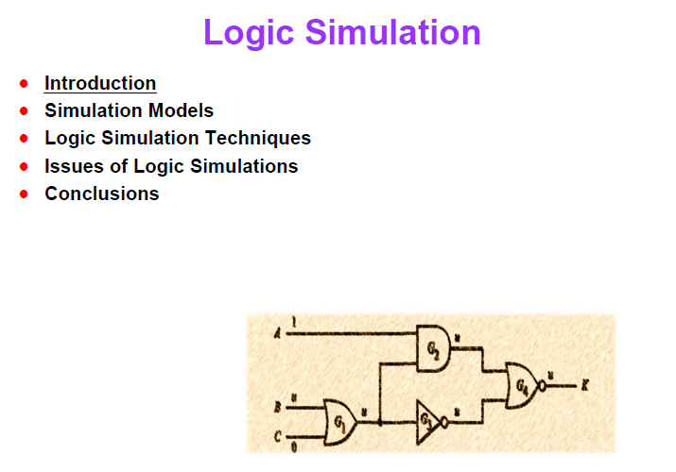

Slide 25
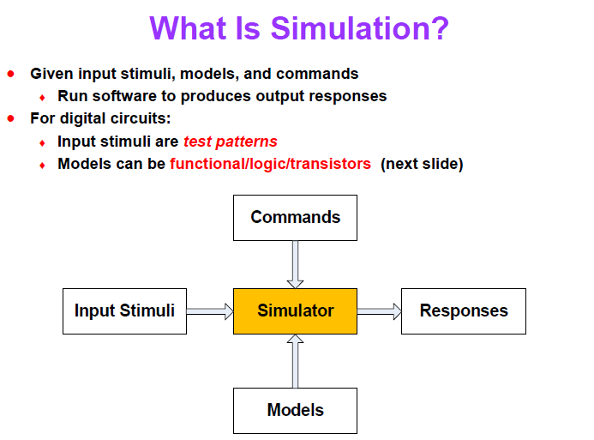

Slide 26
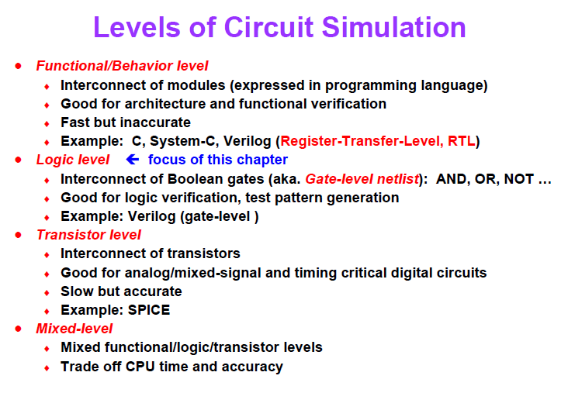

Slide 27
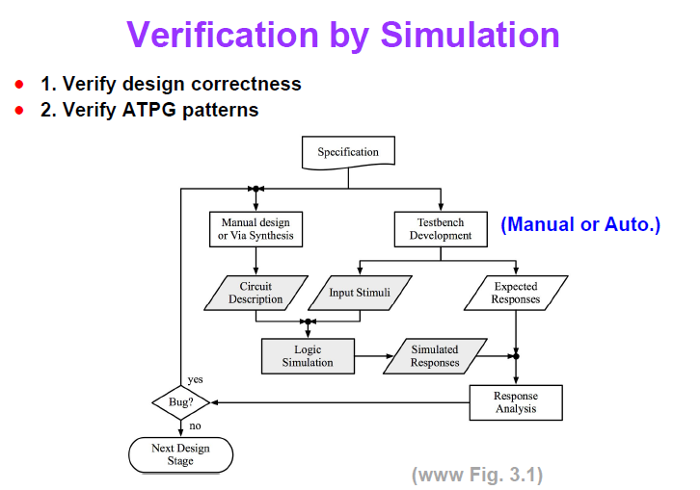

Slide 28
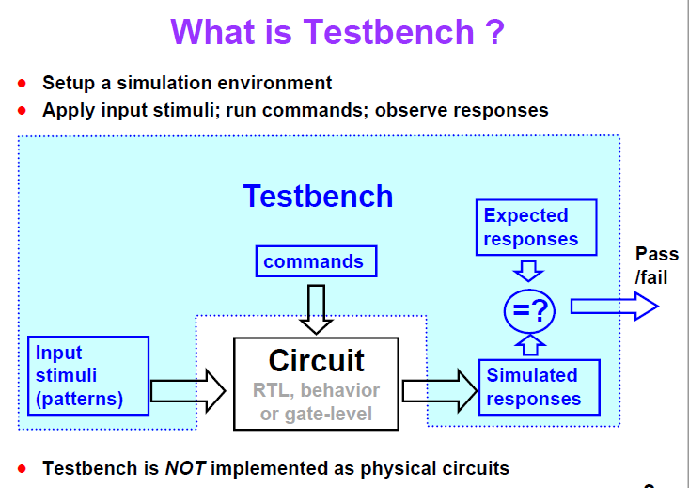

Slide 29
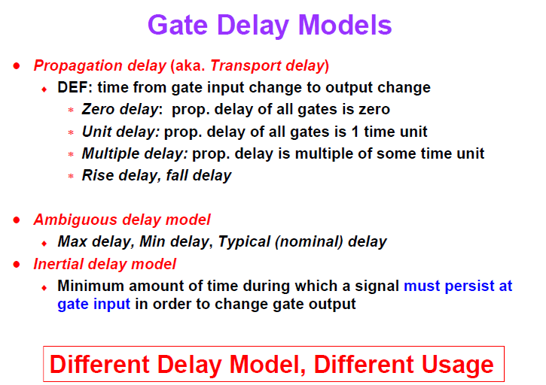

Slide 31
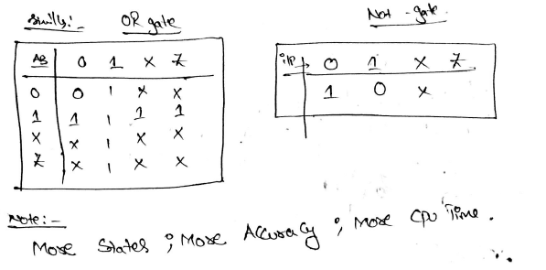

Slide 32
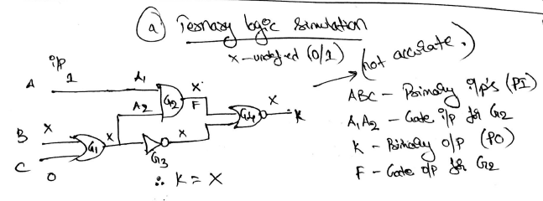

Slide 33
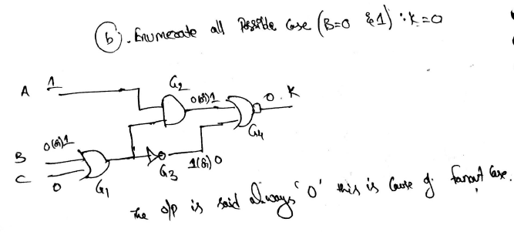
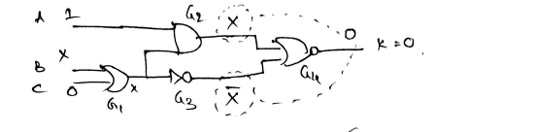

Slide 34
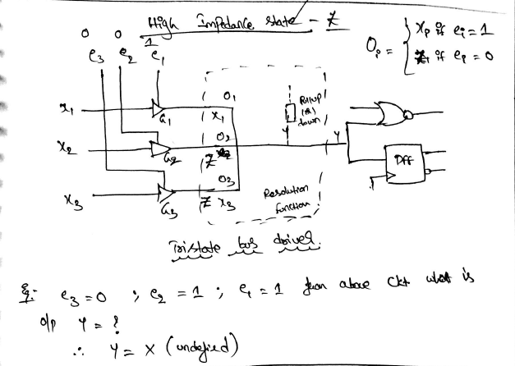

Slide 35
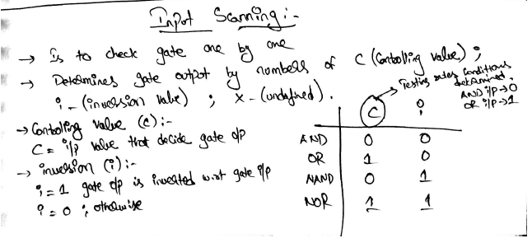

Slide 36
3. Algorithms for True-Value Simulation

Slide 37
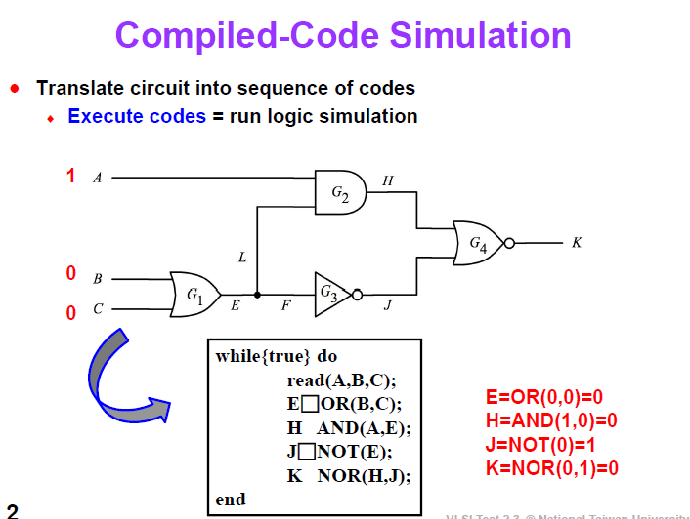

Slide 38
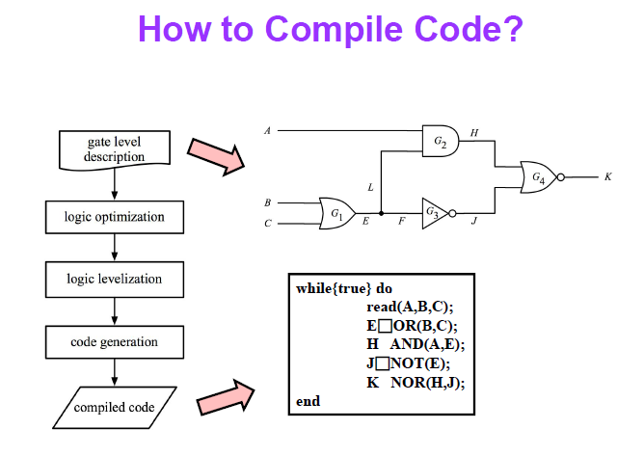

Slide 39
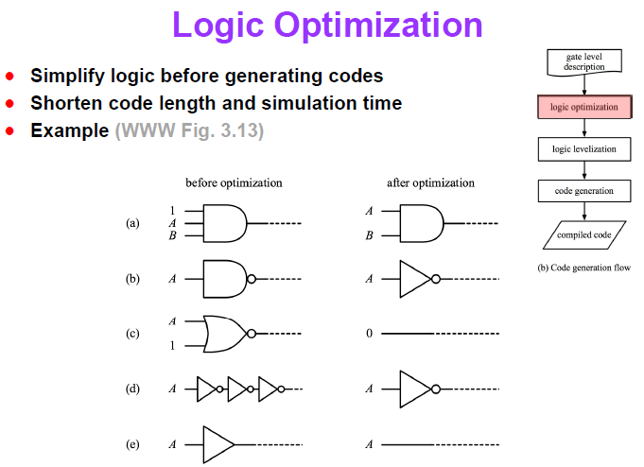

Slide 40
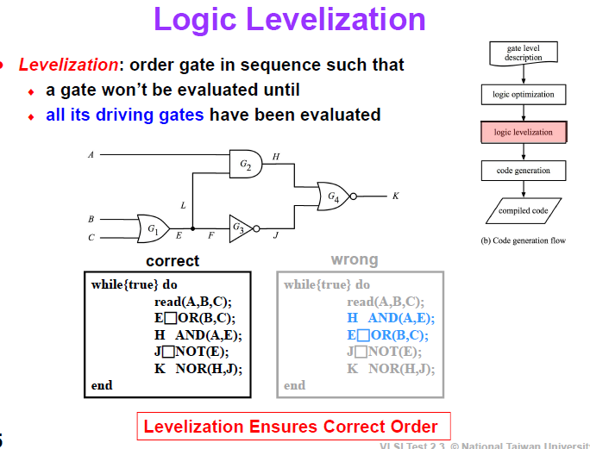

Slide 41
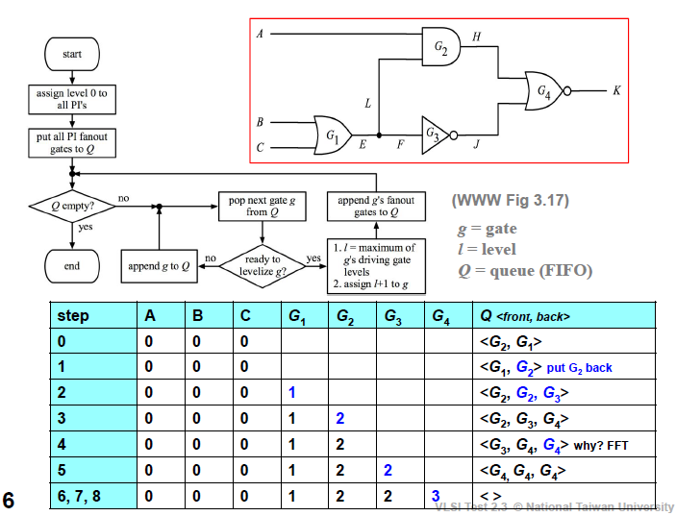
LEVELS
handwritten\new doc 2020-05-14 18.30.43_20200514183135.pdf

Slide 42
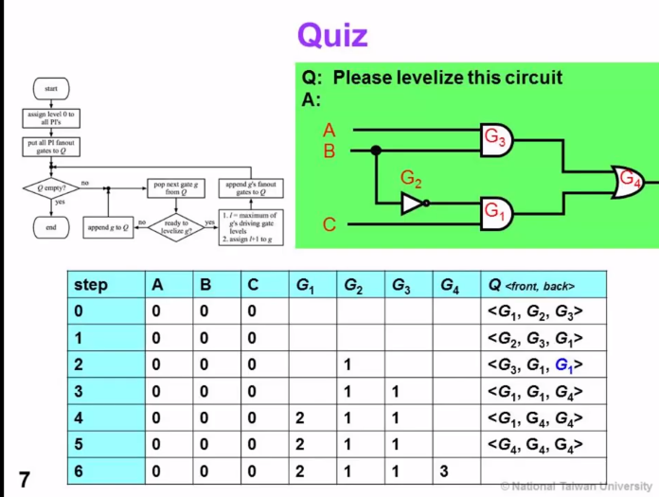

Slide 43
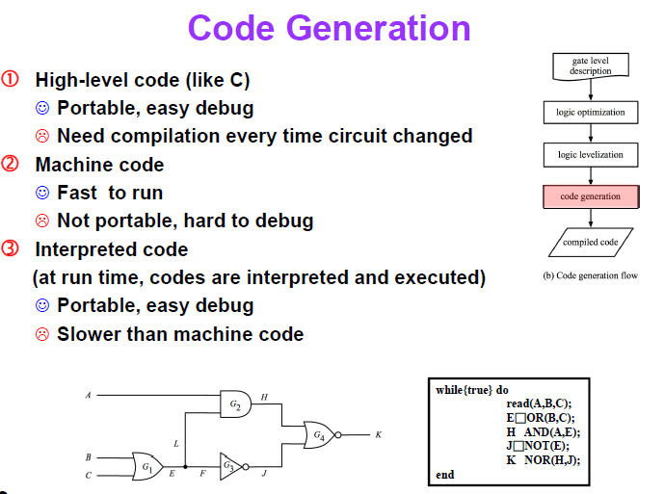

Slide 45
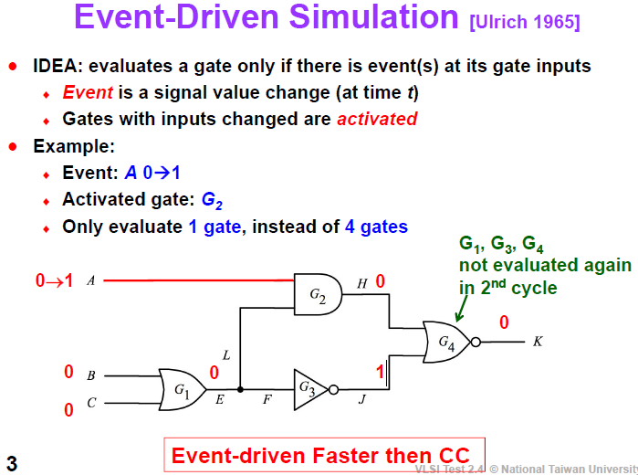

Slide 46
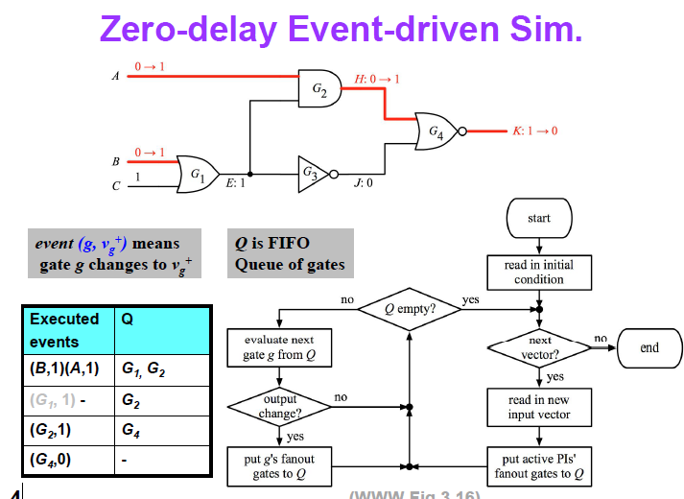
One Pass – Algorithm

Slide 47
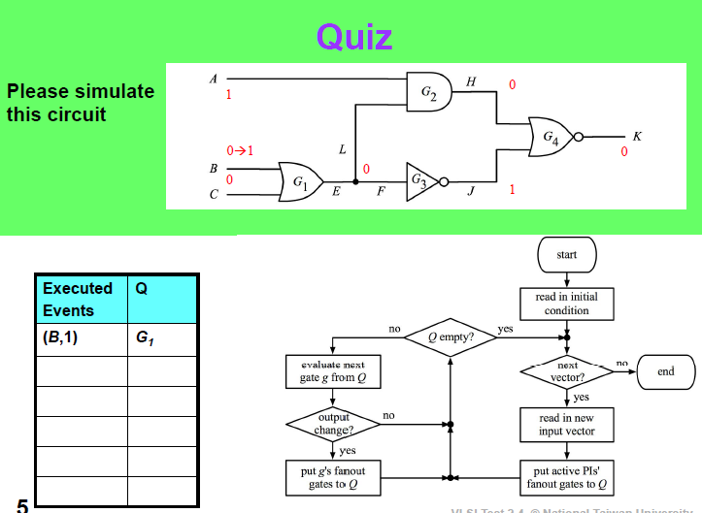

Slide 48
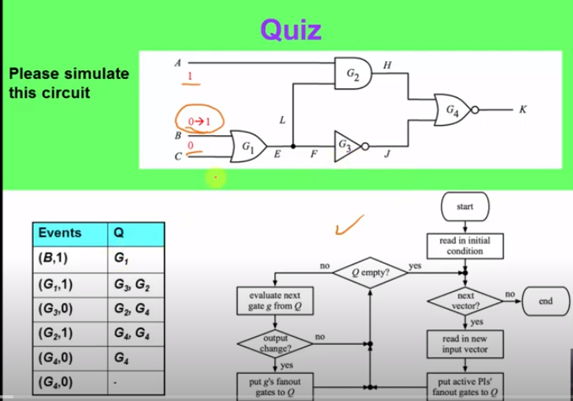

Slide 49
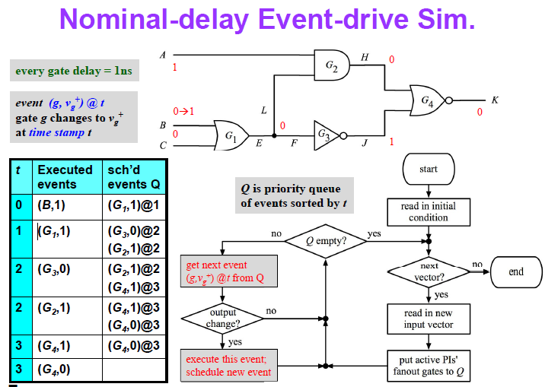

Slide 50
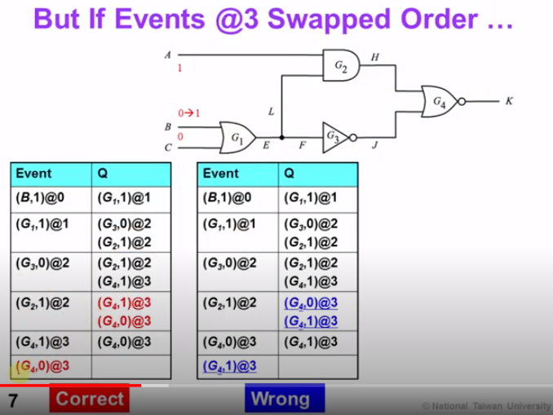

Slide 51
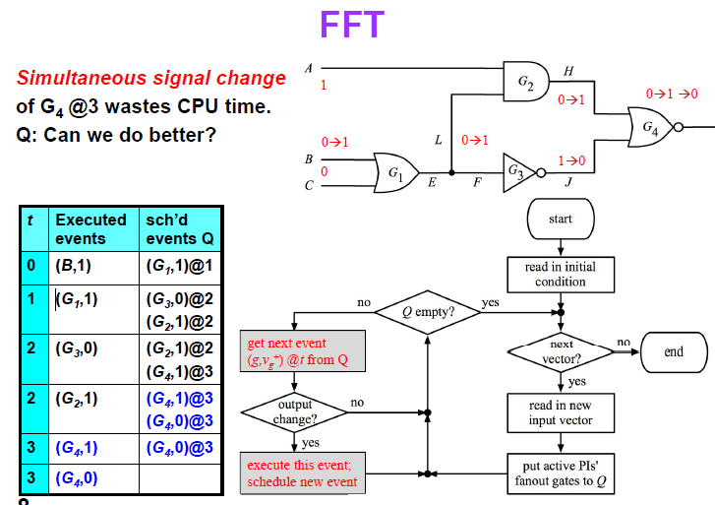

Slide 52
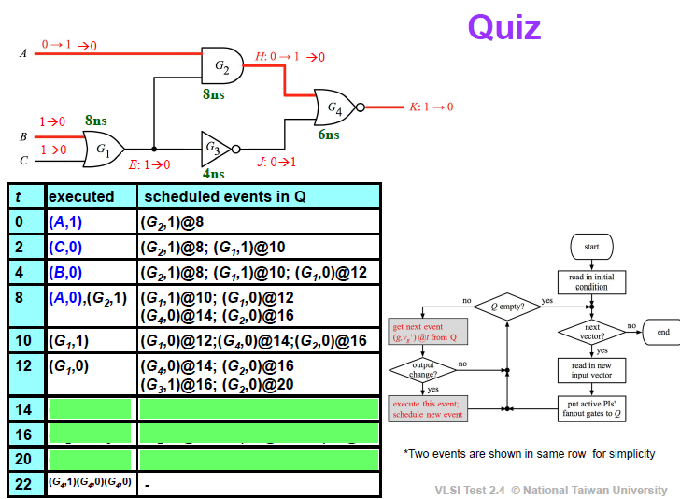

Slide 53
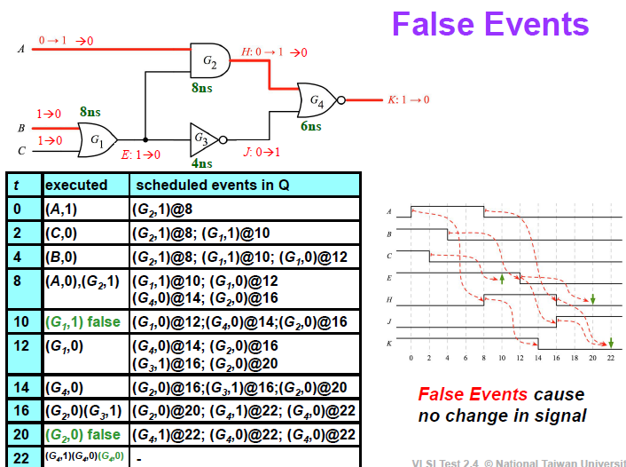

Slide 54
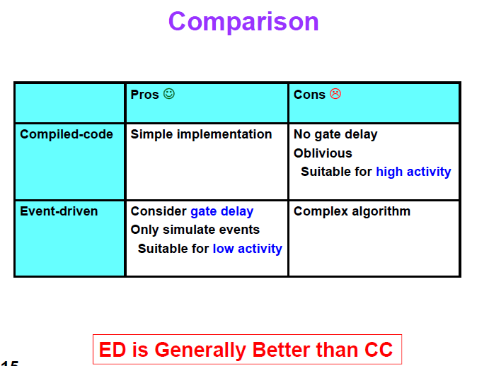

Slide 55
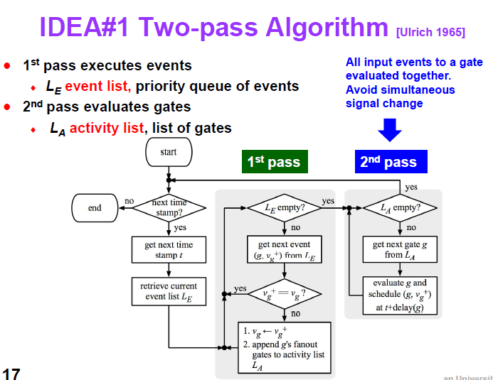

Slide 56
Algorithms for Fault Simulation
Serial Fault Simulation

Slide 57
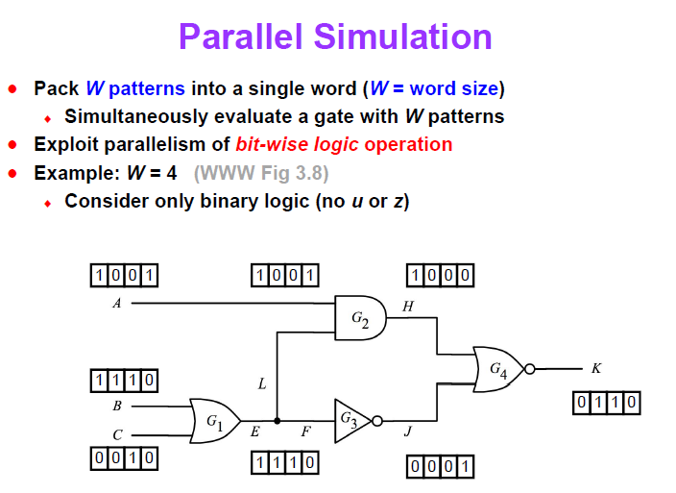
Patterns W=4
1 | 2 | 3 | 4

Slide 58
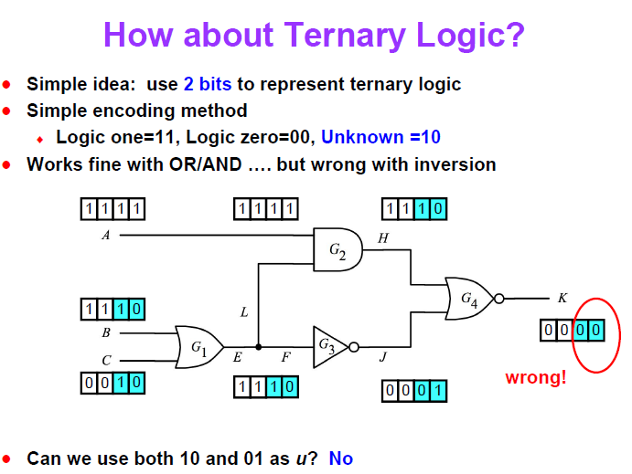
1
x
Correct
wrong
0
x
1
x
1
x

Slide 59
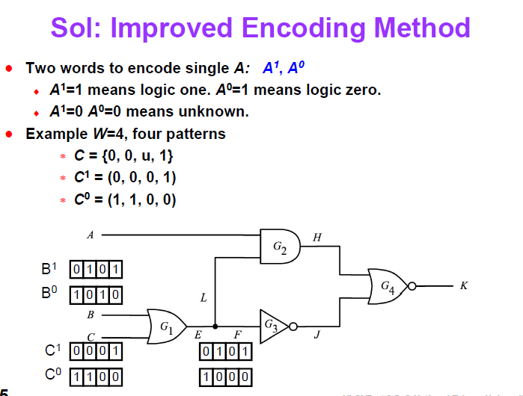
handwritten\new doc 2020-05-22 10.17.30.pdf

Slide 60
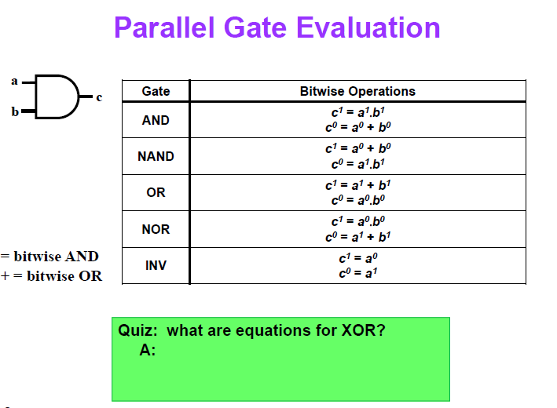
C1 = a1 b0 + a0 b1
C0 = a1 b1 + a0 b0

Slide 61
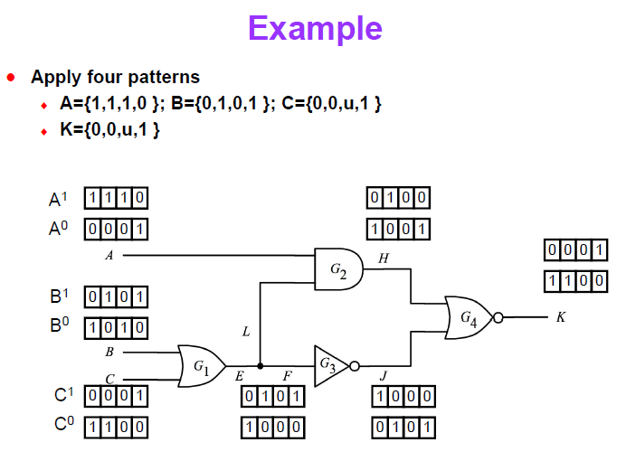

Slide 62


Slide 63

Upper pass- is longer
Lower pass- is Shoter causes rising edge first

Slide 64


Slide 65


Slide 66
1.5.3 Fault Simulation
A fault simulator emulates the target faults in a circuit in order to determine which faults are detected by a given set of test vectors. Because there are many faults to emulate for fault detection analysis, fault simulation time is much greater than that required for design verification.
.
Parallel fault simulation uses bit-parallelism of logical operations in a digital computer. Thus, for a 32-bit machine, 31 faults are simulated simultaneously.
Deductive fault simulation deduces all signal values in each faulty circuit from the fault-free circuit values and the circuit structure in a single pass of true-value simulation augmented with the deductive procedure.
Concurrent fault simulation is essentially an event driven simulation to emulate faults in a circuit in the most efficient way. Hardware fault simulation accelerators based on parallel processing are also available to provide a substantial speed-up over purely software-based fault simulators.
For analog and mixed-signal circuits, fault simulation is traditionally performed at the transistor level using circuit simulators such as HSPICE.
Unfortunately, analog fault simulation is a very time-consuming task and, even for rather simple circuits, a comprehensive fault simulation is normally not feasible.

Slide 67


Slide 68


Slide 69


Slide 70


Slide 71


Slide 72


Slide 73


Slide 74


Slide 75


Slide 76

4/6 = 67%

Slide 77


Slide 78


Slide 79


Slide 80


Slide 81


Slide 82


Slide 83


Slide 84


Slide 85


Slide 86


Slide 87


Slide 88


Slide 89


Slide 90

A- dominant tends b is dominated by a input

Slide 91


Slide 92


Slide 93


Slide 94

00 & 01

Slide 95


Slide 96


Slide 97

Rising edge
Slower Falling edge
input
Falling edge
Slower Falling edge
Falling edge

Slide 98


Slide 99


Slide 100


Slide 101


Slide 102

X 2 = 10 pdf
Falling Transaction input

Slide 103

4*2 = 8

Slide 104


Slide 105


Slide 106


Slide 107


Slide 108


Slide 109


Slide 110


Slide 111


Slide 112


Slide 113


